Slide 1
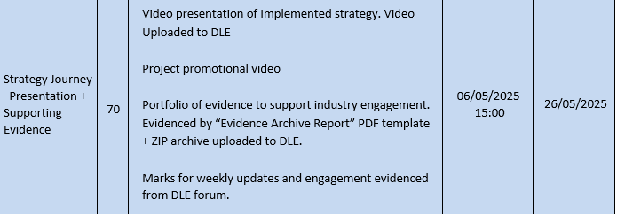

Slide 2
Talk about trailer . Added to itch in report
Trello
Make sure all content is in repo
Vide compression etc
Onedrive?

Slide 3
Some basics
Trello
Organised folders
Update tracking tools
Refer to feedback
Make sure to follow brief carefully check up on the elaborate step or whatever , talk about good bad what to change etc

Slide 4
Journey Pitch ( about 7 – 10 mins)
Your strategy for industry engagement
Analysis and reflection of strategy implementation
highlight the initial strategy identified using smart objectives, outline action taken, roadmap planned, key milestones achieved and external interest or recognition of the process/product.
Use appropriate screen captures, event documentation to convey your ‘journey’ concluding with status of product.
This may include downloaded stats (ITCH GAME JAMS), reviews(ITCH GAME JAMS), exposure achieved etc. Normally this will also include using the various module processes; mind map, SWOT, timeline etc. Remember to inset at a size and resolution where the data can be clearly seen!

Slide 5
Promotional Video ( about 7 – 10 mins)
Not sure what to do it on , Website, Make a trailer ? , Game Jams
The promotional video will normally be for the release version of the prototype tabled at the start of the module. Typically, a code library, asset pack, open-source project, app or game. This can include developer commentary or soundtrack as appropriate for the target audience

Slide 6
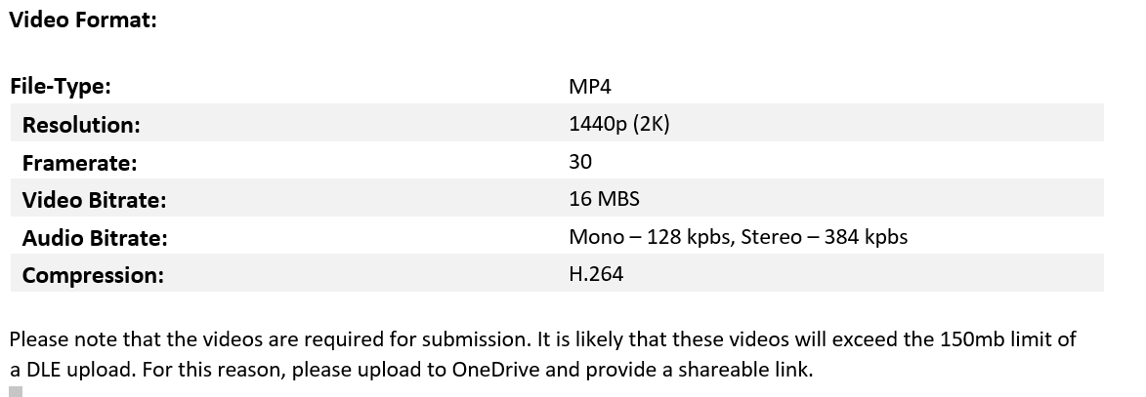
VID GUIDELINES

